Slide 1
Lookup Highschool Test Scores
Group 9

Slide 2
Group 9 Member
Nguyễn Hoàng Phát
Phạm Nguyễn Thùy Dung
Trần Đức Anh
Vạn Minh Ty
Nguyễn Thị Quỳnh Quyên
Chu Hồ Hoàng Vy
Đoàn Hồng Quân
Phạm Quỳnh Hương

Slide 3
TABLE OF CONTENTS
01
02
03
04
INTRODUCE
MAIN CONTENT
RESULTS
CONCLUSIONS

Slide 4
INTRODUCTION
We’ve been working for 22 days for this project
Set up idea less than 7 days

Slide 5
MAIN CONTENT
We using:
-Oracle Database, SpringBoot
-ReactJS-SCSS
-Our Logic and Knowledge

Slide 6
01
02
Database - BE
FE

Slide 7

Result

Slide 8
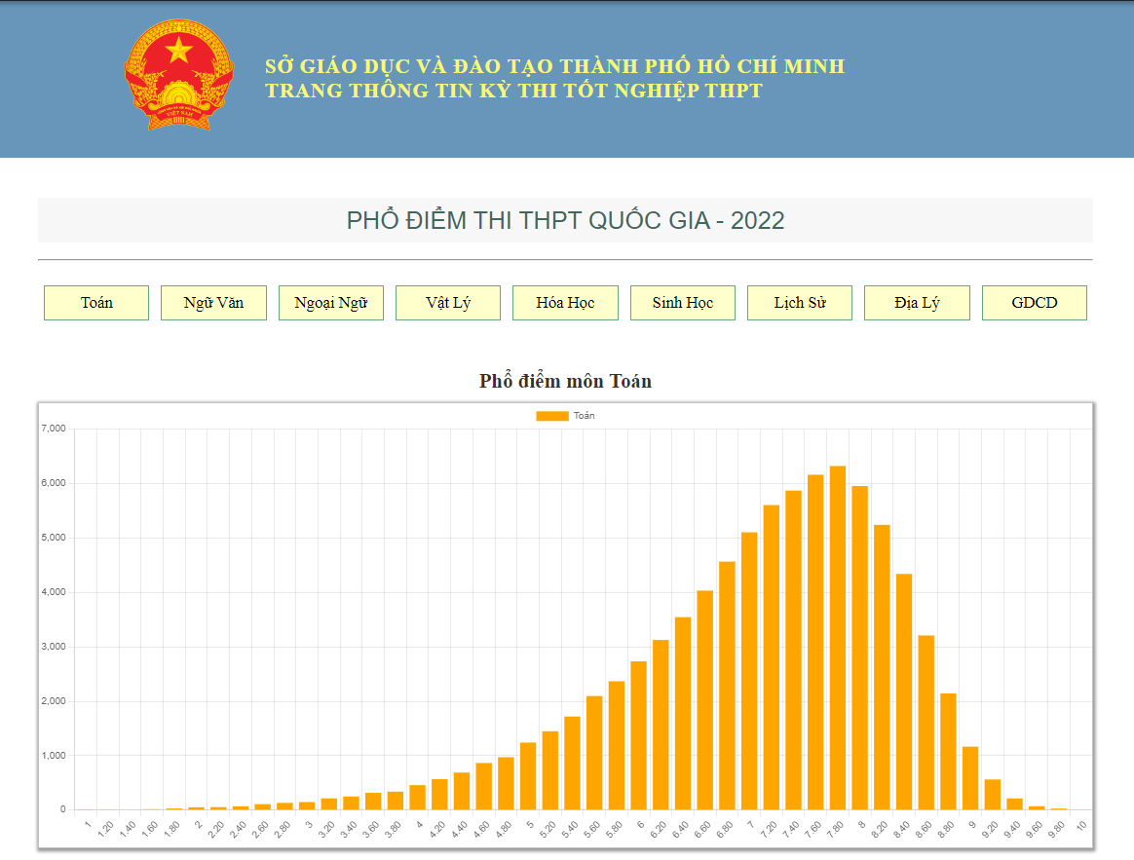
Result

Slide 9
Result
Less talking Start Working

Slide 10
Result
Less talking Start Working

Slide 11
THANKS!
Do you have any questions?

